Slide 1

Ferrara
Brand Websites & Drupal Support Weekly Report
Nov 01st - Nov 04th 2022
Multiple product channels Support
Product Related support on Destini
Prepared by: metacube

Slide 2
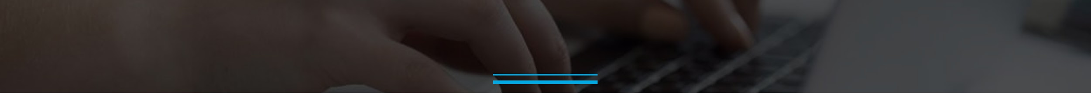
Brand Websites Support Progress
Brand Websites Support | Team Size: 3 Period: Nov 01st - Nov 04th
Completed Activities
[LaffyTaffy] -Analysis of YourJokes page - DONE
[FerraraUsa] - Patents Page - DONE
To Do / In Progress Activities
[Brachs] - Sweetness Swap - Integration Into Consumer Data Cloud
[NowAndLater] - Website Content Refresh

Slide 3
Retrospective
What Went Well
Tickets are resolved on time
Docs are clear to fulfill requirement gathering
Jeera Tickets are created for relevant task
What can be Improved

Slide 4


